Slide 1
PREDICTING CREDIT CARD APPROVALS

Slide 2
OVERVIEW
Purpose
Build an automatic credit card approval predictor to save time and money for commercial banks
Stakeholders
Commercial Banks and other financing entities such as – Credit Unions, Insurance Firms, Brokerages, etc.
Process
Utilizing Machine Learning algorithms to predict credit card approval rates based on raw numerical and categorical customer/applier data

Slide 3
DATA SUMMARY
Categorical Features
Education level
Gender
Employment Status
Previous Default
Married (Marriage Status)
Numerical Features
Credit Score
Income
Age
Years Employed
Debt
Bank Customer
Ethnicity
Citizen
The data was acquired from the UCI Machine Learning Repository.
We have 8 categorical features and 5 numerical features.
The data contained many missing values labelled as ‘?’ and the categorical features had to be recoded since this data was confidential and the contributor of the dataset had anonymized the feature names as well as feature values

Slide 4
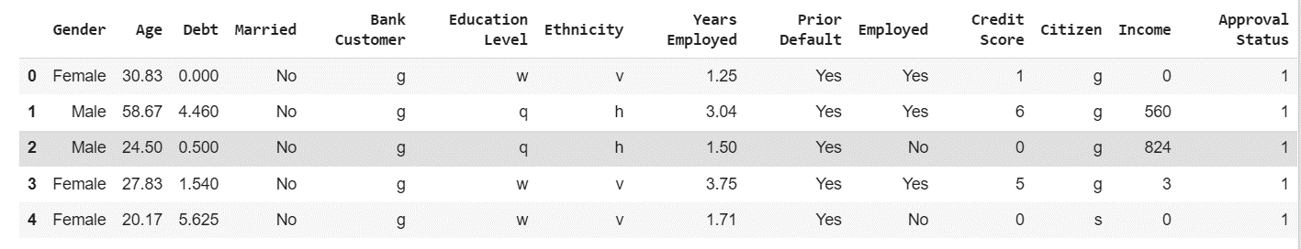
DATA CLEANING
The data cleaning process involved renaming feature/column names due to the data preserving the anonymity of the customers/appliers.
The next step was to replace all ‘?’ values with ‘NaNs’ and then imputing for these missing values.
We then re-coded all categorical feature values (such as setting Married=u as Married=No) except Education Level, ethnicity and Bank Customer status as these were ambiguous with their label meanings.
Finally, we fixed the data types of any wrongly labelled features and asserted that there were no more missing/wrongful values in the dataset.

Slide 5
EXPLORATORY DATA ANALYSIS
Women had a higher number of applications accepted as well as applications rejected than men.
Older people had a higher chance of getting their credit card issue requests approved.
Surprisingly, people with more debt had more applications approved (could be attributed to other more important deciding factors).
This indicates that people already in debt apply more for credit cards than people not in as much debt which is synonymous with human behaviour.
More unmarried people apply for credit cards than married people and subsequently get accepted/rejected more than married people do.
People with higher credit scores, incomes, and employment years (experience) have a higher chance of getting approved for a credit card.
More people with prior defaults are accepted for a credit card than people with no defaults which is very surprising and goes against usual norms.
Finally, employed people have a higher success rate with their applications than unemployed people.

Slide 6
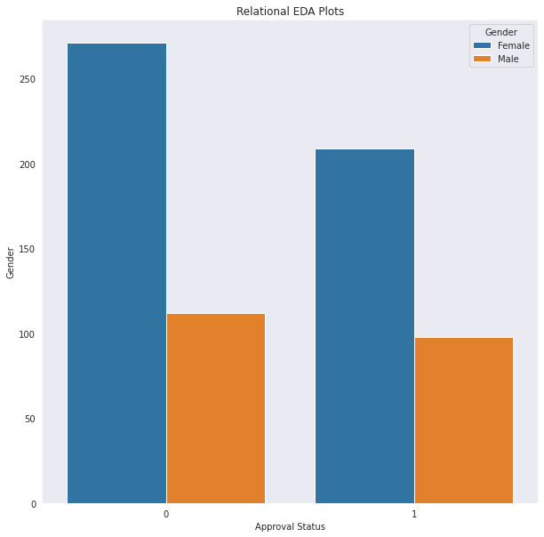
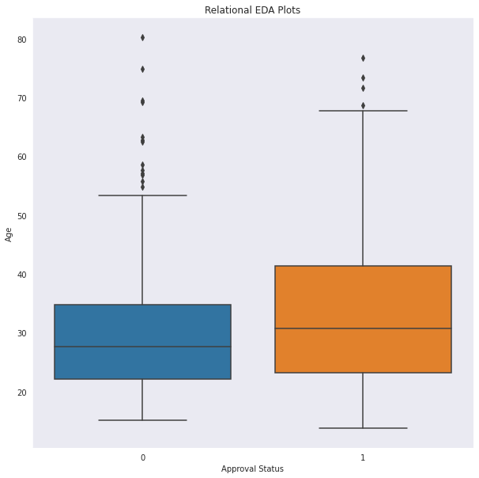
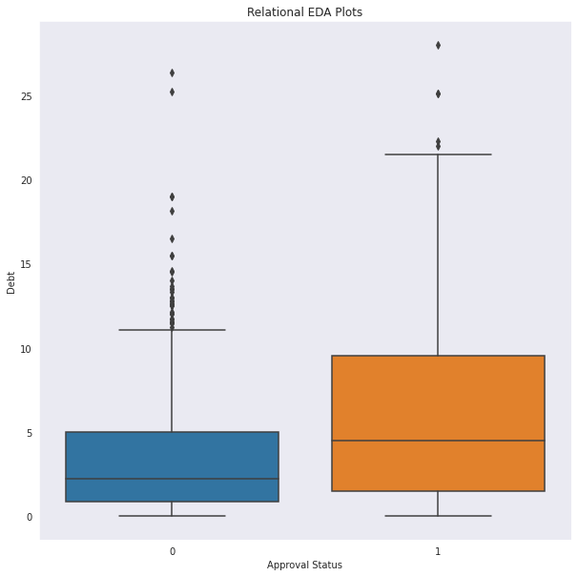
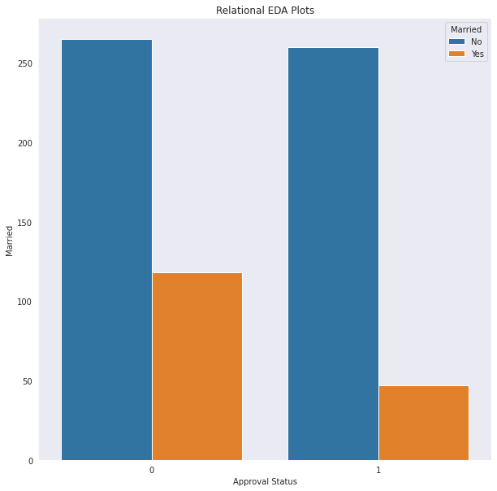

Slide 7
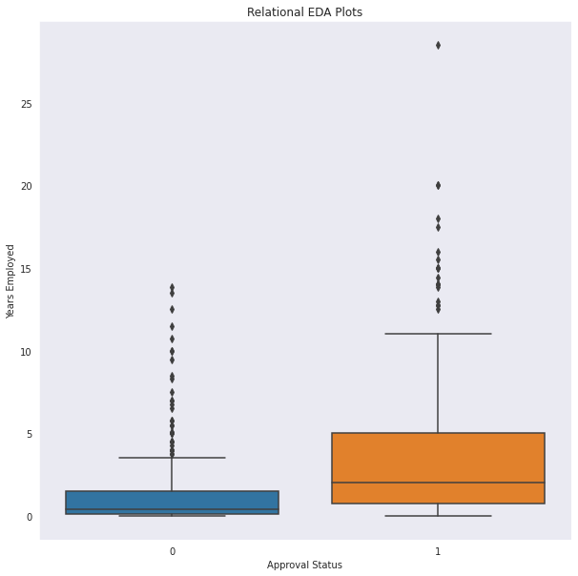
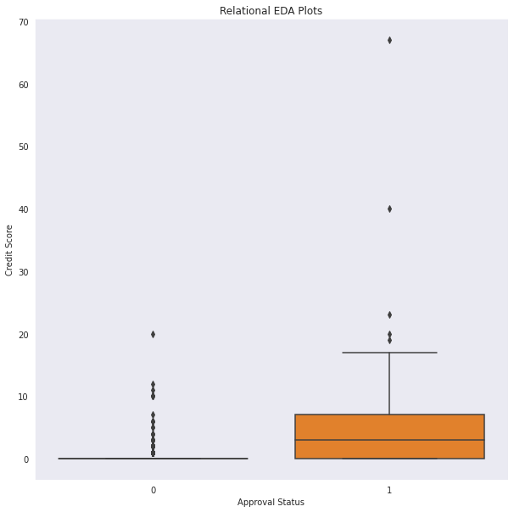
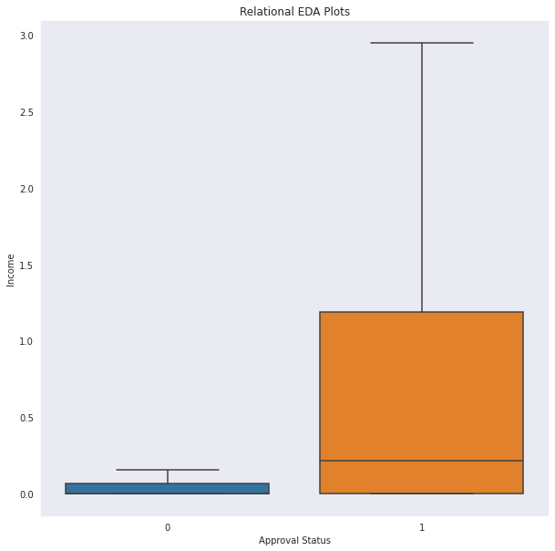
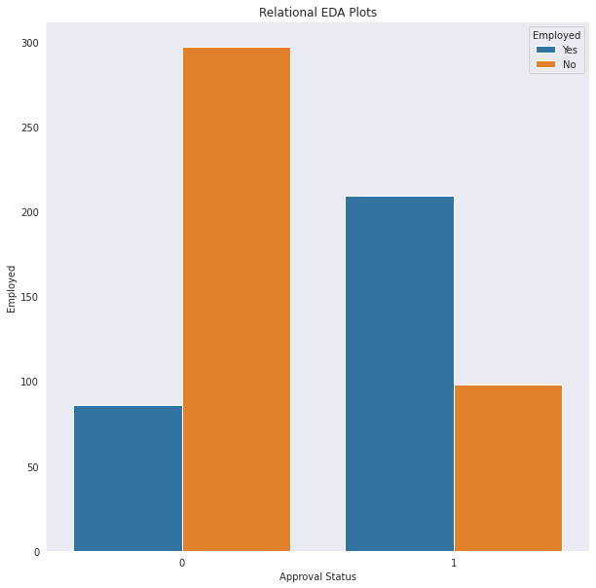
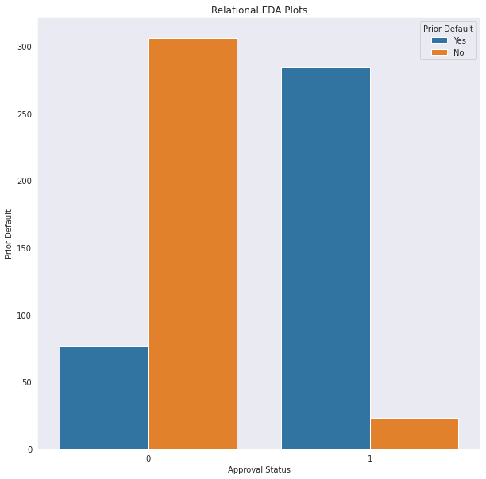

Slide 8
FEATURE SELECTION
As stated we had 12 features overall – 7 categorical, 5 numerical.
We dropped DL and Zip-code from our feature set as they only provided random noise to the dataset.
All categorical features were converted to numerical dummies.
Even though Education Status was ordinal in nature, it couldn’t be recoded as such due to the anonymity of the arbitrarily labelled values of the feature.

Slide 9
MODELLING
We employed a Logistic Regression Model to classify an approval or a lack of one for each credit card applicant.
We scaled and imputed the observations and missing values using the MinMaxScaler and manual methods respectively for the purposes of pre-processing data to get it ready for analysis.
Further, we recoded categorical data using pandas’ get_dummies() method.
Finally, we made use of GidSearchCV to tune the model through a variety of hyperparameters and selected the best specification using cross-validation methods on the numerous specifications.
We also coded another DataFrame to visualize feature importances.

Slide 10
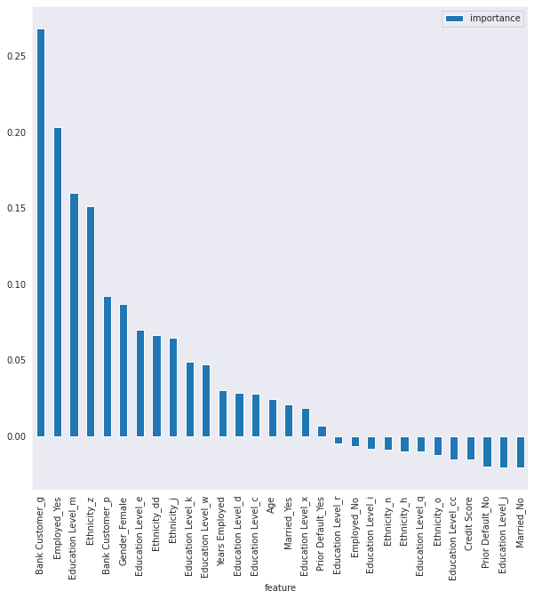
MODEL EVALUATION
Accuracy: 0.987
Best CV Score: 0.994
Best λ: (max_iter=100, tol=0.01)
Precision: 0.95
Recall=0.91

Slide 11
FURTHER STEPS
The next steps would be to incorporate other features and/or include polynomial features.
Another thing to note would be to encode ordinal categorical features in an ascending/descending order so as to capture their effect more.
Investigating further to understand why people with prior defaults landed more approvals or any approvals at all.
Finally, improve upon the project by incorporating other classifier algorithms such as KNN Classifiers or Decision Tree Classifiers.

